Slide 1
Introduction of deep learning
Sanzhen Liu
PLPTH813
4/29/2025

Slide 2
review
Gene co-expression networks
Pearson correlation can be used to measure the expression similarity of two genes
Gene | s1 | s2 | …
Gi | 4 | 2 | …
Gj | 0 | 3 | …
$$cor(x_{i},x_{j})$$
Notes:
We denote the gene co-expression similarity measure of a pair of genes i and j by Sij. Many co-expression studies use the absolute value of the correlation as an unsigned co-expression similarity measure

Slide 3
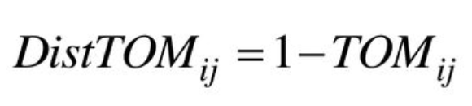
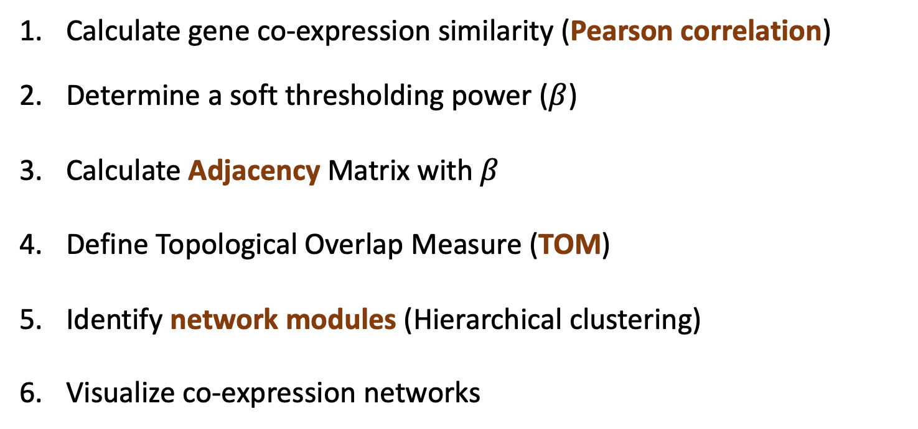
WGCNA
review
Calculate gene co-expression similarity (Pearson correlation)
Determine a soft thresholding power ($β$)
Calculate Adjacency Matrix with $β$
Define Topological Overlap Measure (TOM)
Identify network modules (Hierarchical clustering)
Visualize co-expression networks

Slide 4
Outline
What is deep learning?
How does neural network work?
Protein/DNA LLM
Goal: to introduce basic knowledge for AI computational tools

Slide 5
AI, machine learning, deep learning
Artificial intelligence (AI) refers to the simulation of human intelligence in machines that are programmed to think like humans and mimic their actions (e.g., learning and problem-solving)
Machine learning: the use and development of computer systems that can learn and adapt by using algorithms to draw inferences from patterns in data.
Artificial
Intelligence
Machine
Learning
Deep
Learning
Notes:
Artificial intelligence (AI) refers to the simulation of human intelligence in machines that are programmed to think like humans and mimic their actions. The term may also be applied to any machine that exhibits traits associated with a human mind such as learning and problem-solving.
Machine learning: the use and development of computer systems that are able to learn and adapt by using algorithms and statistical models to draw inferences from patterns in data.

Slide 6
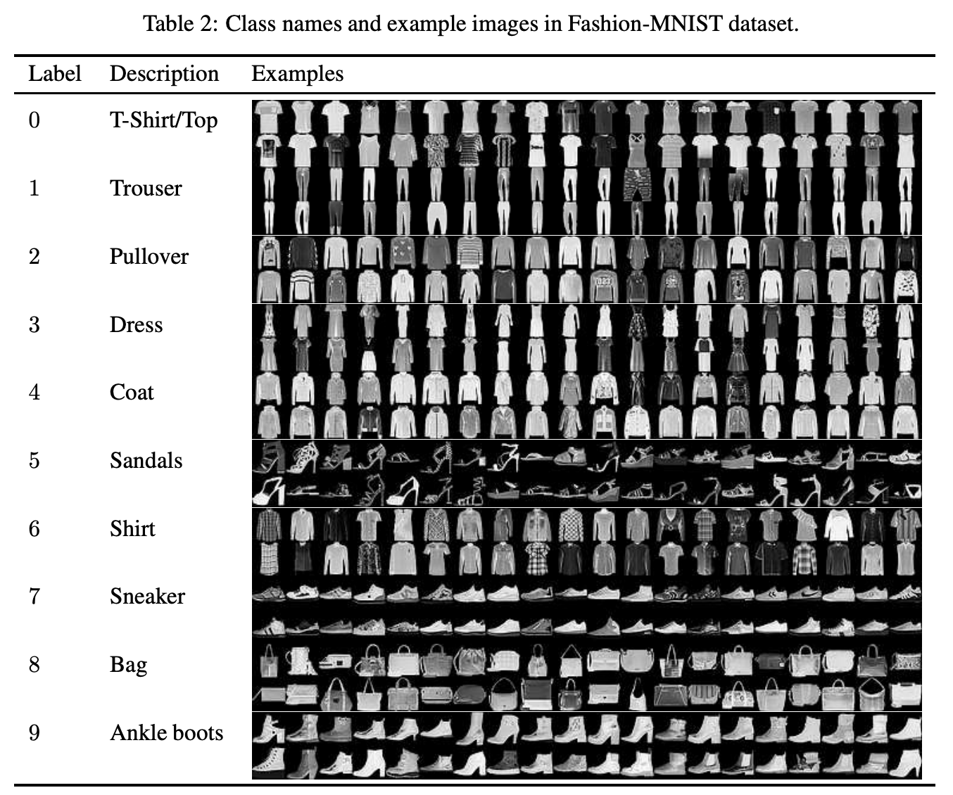
Supervised and unsupervised (major methods)
Supervised: to predict response (regression) or classification of each data point by using a set of labeled training examples
Unsupervised (to learn inherent patterns within data)
e.g., clustering

Slide 7
Supervised: regression and classification
A regression model predicts continuous values
What is the value of a house in California?
What is the probability that a user will click on an ad?
A classification model predicts discrete values
Is a given email message spam or not spam?
Is this an image of a dog, a cat, or a hamster?

Slide 8
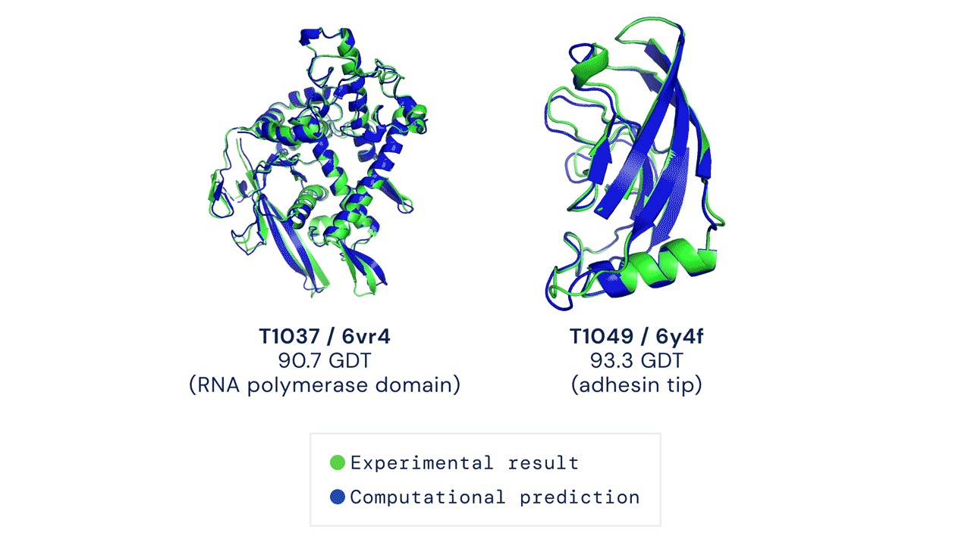
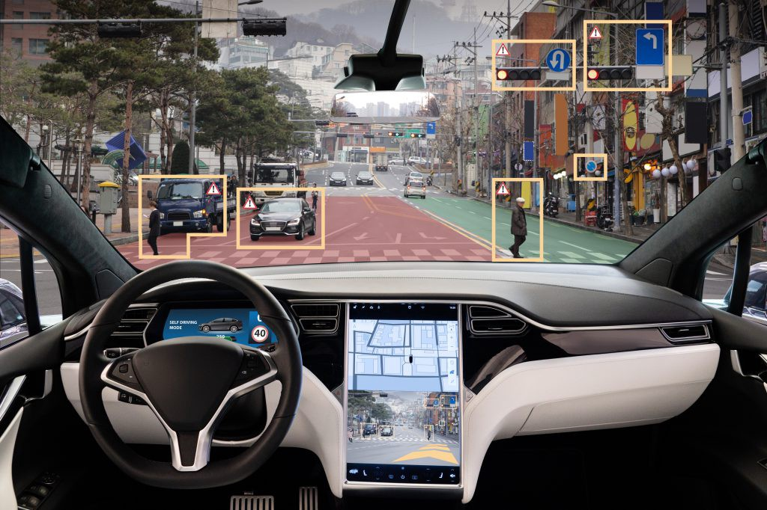
Why does AI become more powerful?
Improved algorithms and theories
Increased computational power
Large data
autopilot
medium.com
AlphaFold

Slide 9
General procedure (supervised)
optimization procedure
To find a model for small loss
dataset
(features)
model
Prediction
Prediction loss
Dataset (label)
location, room, area, …
house price
edu, org, spam_words, …
spam (0 or 1)

Slide 10
Components
Common components of nearly all machine learning algorithms:
dataset (training data)
cost function (loss function)
model
optimization procedure
optimization procedure
To find a model to minimize loss
dataset
(features)
model
Prediction
Prediction loss
Dataset (label)

Slide 11
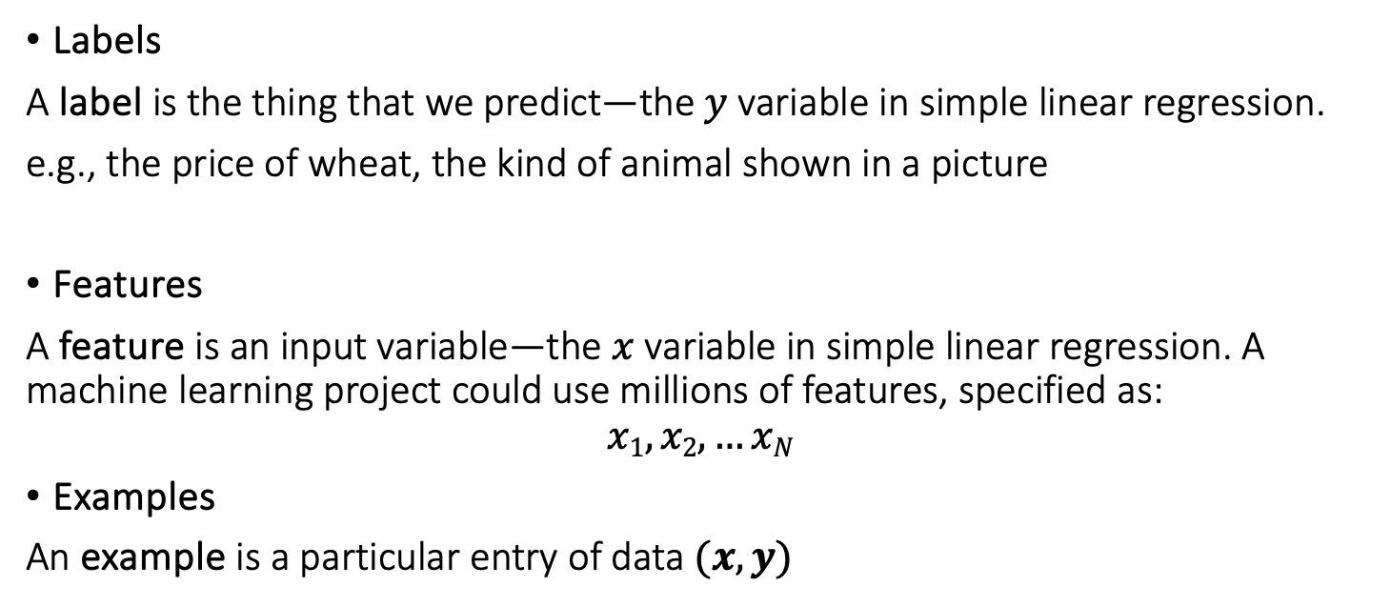
Training data
Labels
A label is the thing that we predict—the $y$ variable in simple linear regression.
e.g., the price of wheat, the kind of animal shown in a picture
Features
A feature is an input variable—the $x$ variable in simple linear regression. A machine learning project could use millions of features, specified as:
$$x1,x2,…xN$$
Examples
An example is a particular entry of data $(x, y)$

Slide 12
Training data - example
https://arxiv.org/pdf/1708.07747.pdf

Slide 13
Features of image 1
[,1] [,2] [,3] [,4] [,5] [,6] [,7] [,8] [,9] [,10] [,11] [,12] [,13] [,14] …
[1,] 0 0 0 0 0 0 0 0 0 0 0 0 0 0
[2,] 0 0 0 0 0 0 0 0 0 0 0 0 0 0
[3,] 0 0 0 0 0 0 0 0 0 0 0 0 0 0
[4,] 0 0 0 0 0 0 0 0 0 0 0 0 1 0
[5,] 0 0 0 0 0 0 0 0 0 0 0 0 3 0
[6,] 0 0 0 0 0 0 0 0 0 0 0 0 6 0
[7,] 0 0 0 0 0 0 0 0 0 0 0 0 0 0
[8,] 0 0 0 0 0 0 0 0 0 0 0 1 0 69
[9,] 0 0 0 0 0 0 0 0 0 1 1 1 0 200
[10,] 0 0 0 0 0 0 0 0 0 0 0 0 0 183
[11,] 0 0 0 0 0 0 0 0 0 0 0 0 0 193
[12,] 0 0 0 0 0 0 0 0 0 1 3 0 12 219
[13,] 0 0 0 0 0 0 0 0 0 0 6 0 99 244
[14,] 0 0 0 0 0 0 0 0 0 4 0 0 55 236
[15,] 0 0 1 4 6 7 2 0 0 0 0 0 237 226
[16,] 0 3 0 0 0 0 0 0 0 62 145 204 228 207
[17,] 0 0 0 0 18 44 82 107 189 228 220 222 217 226
[18,] 0 57 187 208 224 221 224 208 204 214 208 209 200 159
[19,] 3 202 228 224 221 211 211 214 205 205 205 220 240 80
[20,] 98 233 198 210 222 229 229 234 249 220 194 215 217 241
[21,] 75 204 212 204 193 205 211 225 216 185 197 206 198 213
[22,] 48 203 183 194 213 197 185 190 194 192 202 214 219 221
[23,] 0 122 219 193 179 171 183 196 204 210 213 207 211 210
[24,] 0 0 74 189 212 191 175 172 175 181 185 188 189 188
[25,] 2 0 0 0 66 200 222 237 239 242 246 243 244 221
[26,] 0 0 0 0 0 0 0 40 61 44 72 41 35 0
[27,] 0 0 0 0 0 0 0 0 0 0 0 0 0 0
[28,] 0 0 0 0 0 0 0 0 0 0 0 0 0 0
28 × 28 grayscale
Label = 9
Ankle boots

Slide 14
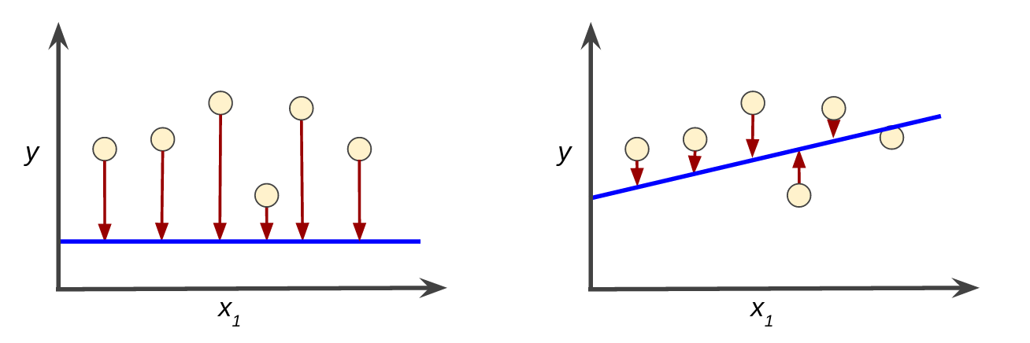
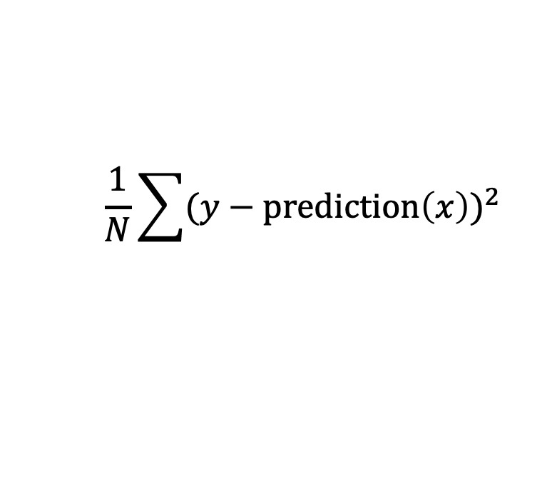
Loss function for a simple linear regression
Loss is the penalty for a prediction.
$$\frac{1}{N}\sum{(y−prediction\left(x\right))^{2}}$$
Loss function:
Training a model is to find a set of weights (parameters) that have a low loss, on average, across all examples.

Slide 15
Neural networks: a main form of deep learning
Neural network is a major deep learning approach
Algorithms trying to mimic the brain
Widely used in 80s and early 90s; popularity diminished in late 90s but resurged recently

Slide 16
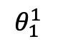
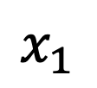
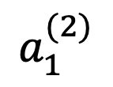
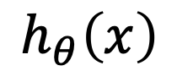
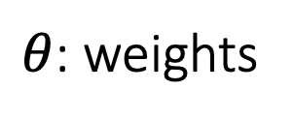
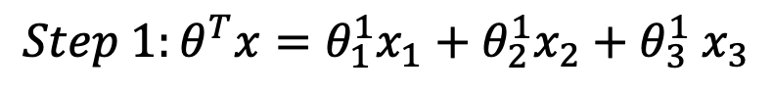
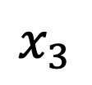
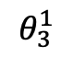
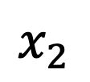
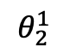
Neuron model
Features (input)
$$x_{1}$$
$$θ_{1}^{1}$$
unit
(output)
$$x_{2}$$
$$θ_{2}^{1}$$
$$a_{1}^{(2)}$$
$$h_{θ}\left(x\right)$$
$θ$: weights
$$θ_{3}^{1}$$
$$x_{3}$$
$${{Step 1:θ}^{T}x=θ}_{1}^{1}x_{1}+θ_{2}^{1}x_{2}{+ θ}_{3}^{1}x_{3}$$
Layer 1
Input layer
Layer 2
Output layer
Step 2: activation

Slide 17

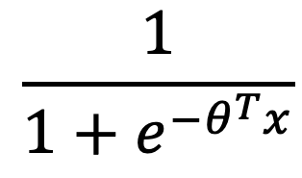

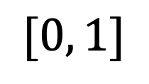
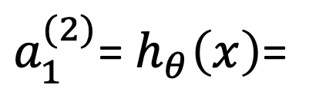
Activation function: Sigmoid (logistic)
$$[0, 1]$$
$$\frac{1}{1+e^{−θ^{T}x}}$$
$a_{1}^{(2)}$= $h_{θ}\left(x\right)$=
$$θ^{T}x$$

Slide 18
Activation function: ReLU (rectified linear activation function)
y
3
2
y = max(0, x)
1
x
-3
-2
-1
1
2
3
-1
-2
-3

Slide 19
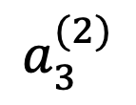
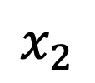
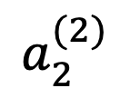
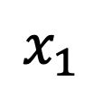
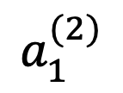
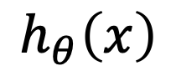
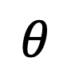
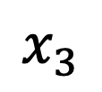
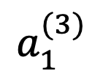
Neural Network
Features
(input)
units
$$θ$$
$$x_{1}$$
$$a_{1}^{(2)}$$
$$x_{2}$$
$$a_{2}^{(2)}$$
$$a_{1}^{(3)}$$
$$h_{θ}\left(x\right)$$
(output)
$$x_{3}$$
$$a_{3}^{(2)}$$
Layer 1
Layer 2
hidden layer
Layer 3

Slide 20
Neural network architecture
3 layers
3 units in 2nd layer
4 layers
5 units in 2nd layer
…

Slide 21
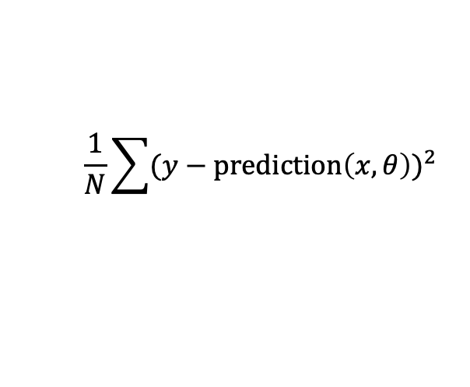
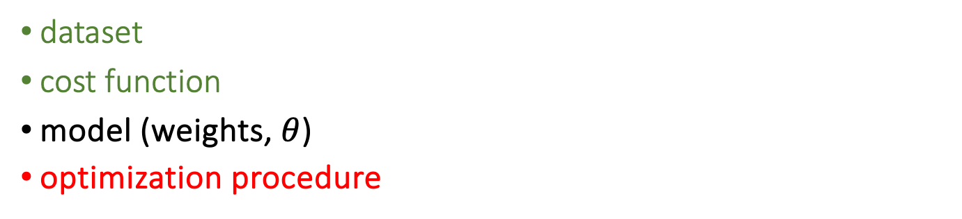
training process
dataset
cost function
model (weights, $θ$)
optimization procedure
$$\frac{1}{N}\sum{(y−prediction\left(x,θ\right))^{2}}$$
optimization procedure
To find a model to minimize loss
dataset
(features)
model
Prediction
Prediction loss
Dataset (label)

Slide 22
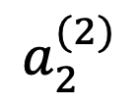
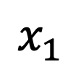
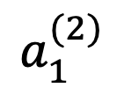
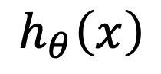
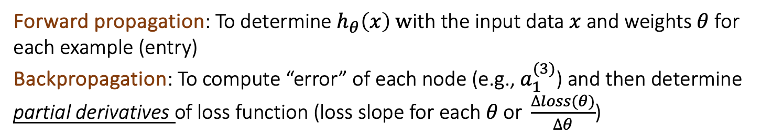
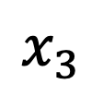
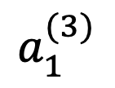
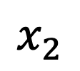
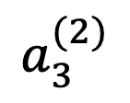
Forward propagation and backpropagation
$$x_{1}$$
$$a_{1}^{(2)}$$
$$x_{2}$$
$$a_{2}^{(2)}$$
$$a_{1}^{(3)}$$
$$h_{θ}\left(x\right)$$
$$x_{3}$$
$$a_{3}^{(2)}$$
Forward propagation: To determine $h_{θ}\left(x\right) w$ith the input data $x$ and weights $θ$ for each example (entry)
Backpropagation: To compute “error” of each node (e.g.,${ a}_{1}^{(3)}$) and then determine partial derivatives of loss function (loss slope for each $θ \text{or} \frac{∆loss(θ)}{∆θ}$)

Slide 23
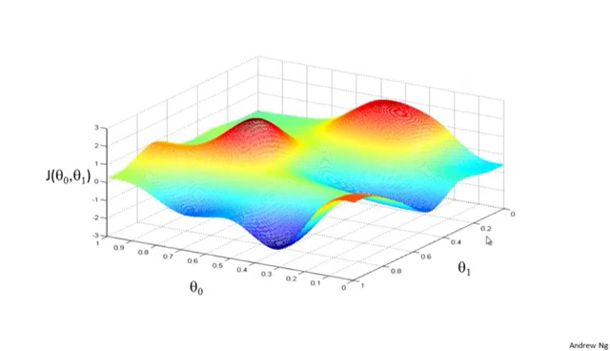
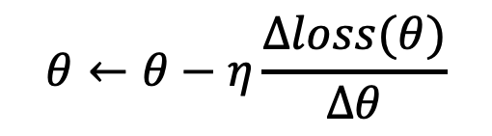
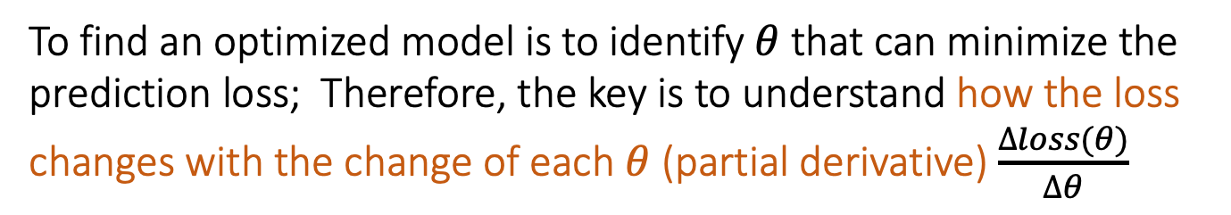
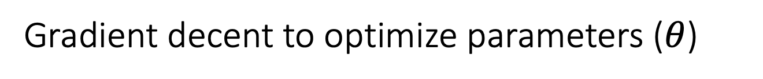
Gradient decent to optimize parameters ($θ$)
$$θ←θ−η\frac{∆loss(θ)}{∆θ}$$
To find an optimized model is to identify $θ$that can minimize the prediction loss; Therefore, the key is to understand how the loss changes with the change of each $θ$ (partial derivative) $\frac{∆loss(θ)}{∆θ}$
Notes:
Determine “landscapes”; employ gradient decent to find a spot; then “theta” was determined

Slide 24
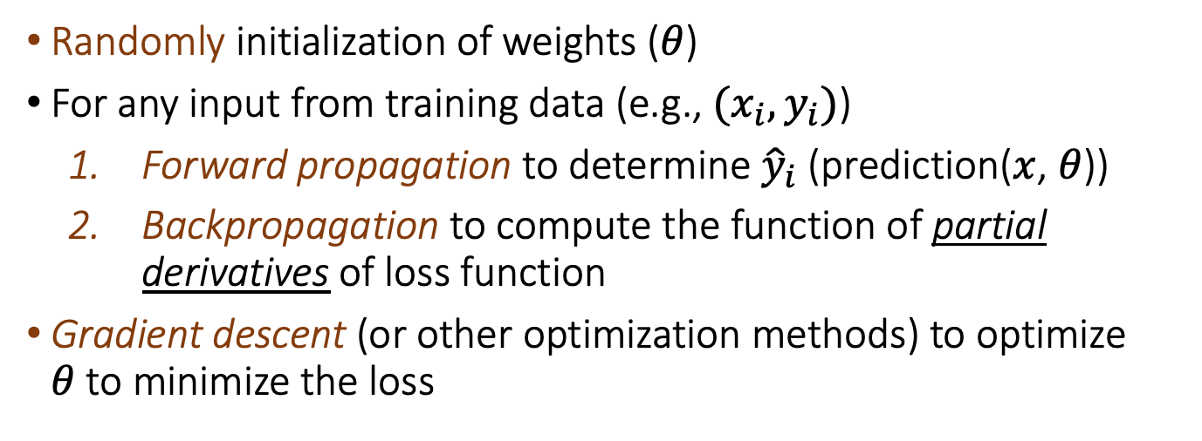
Procedure of neural network (one typical method)
Randomly initialization of weights ($θ$)
For any input from training data (e.g., ${(x}_{i},y_{i})$)
Forward propagation to determine ${\hat{y}}_{i}$ (prediction($x$, $θ$))
Backpropagation to compute the function of partial derivatives of loss function
Gradient descent (or other optimization methods) to optimize $θ$to minimize the loss

Slide 25
How can we know if a model trained is a good predictor?
Training set
to learn the model weights
Validation set
- to select the best model
Test set
to estimate the generalization

Slide 26

underﬁtting and overﬁtting
Underﬁtting occurs when the model obtains an insuﬃciently low error value on the training set.
Overﬁtting occurs when the gap between the training error and test/validation error is too large.

Slide 27
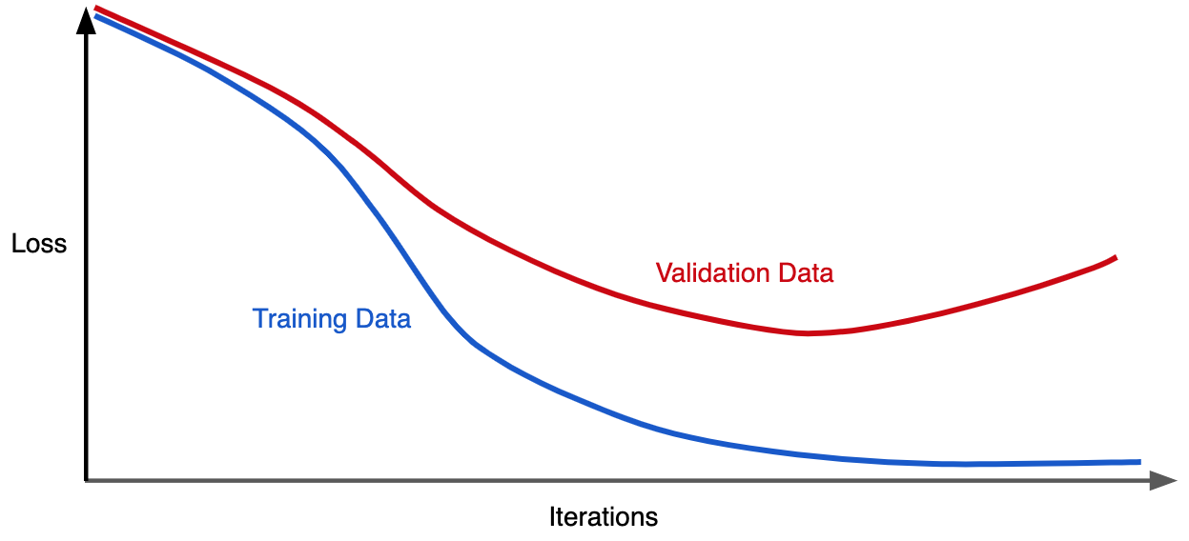
underﬁtting and overﬁtting
Make the training error small.
Make the gap between training and validation error small.

Slide 28
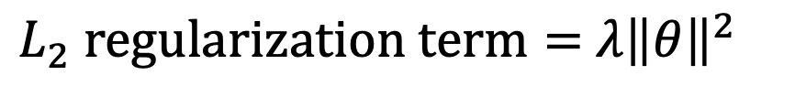
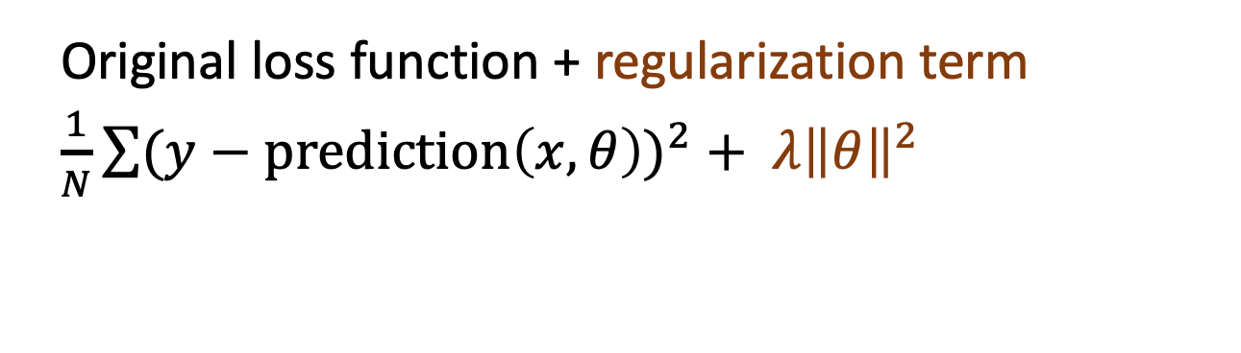
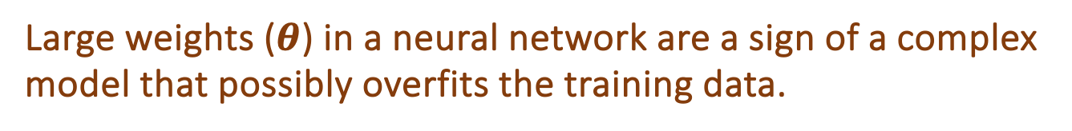

regularization
Regularization refers to techniques that lower the complexity of a neural network model during training, and thus prevent the overfitting.
Large weights ($θ$) in a neural network are a sign of a complex model that possibly overfits the training data.
Original loss function + regularization term
$\frac{1}{N}\sum{(y−prediction\left(x,θ\right))^{2}}+ λ{\left\|θ\right\|}^{2}$
$λ$: weight of regulation
${\left\|θ\right\|}^{2}$: sum of square
$L_{2} regularization term=$ $λ{\left\|θ\right\|}^{2}$

Slide 29
Dropout: a simple and effective regularization method
A model is adjusted by dropping out nodes during training. The node is temporarily removed from the network, along with all its incoming and outgoing connections.
Dropout is a computationally cheap and remarkably effective regularization method to reduce overfitting and improve generalization in deep neural networks of all kinds.
https://machinelearningmastery.com/dropout-for-regularizing-deep-neural-networks/

Slide 30
software
Tensorflow: a platform developed by the Google Brain team for machine learning.
Keras: a deep learning software written in Python, running on top of the machine learning platform TensorFlow.
PyTorch, developed by Facebook AI Research, is a machine learning framework for building and deploying deep learning models.

Slide 31
Deep learning in genomics
Large training datasets (e.g., thousands of examples), curated to remove confounders, are typically required.
Most genomic data do not require very deep networks.
Researchers must be wary of high accuracy due to data imbalance or bias that makes classification too easy.
A good practice is to compare against simpler machine learning models on the same dataset.
Deep learning can achieve high accuracy, but the interpretation of results is more challenging than for standard statistical models.

Slide 32


AI models for predicting effects of genomic variants
Protein large Language Model (LLM)
Esm1b
DNA LLM
plantCAD

Slide 33

ESM-variant for variant effect prediction

Slide 34

Prediction of pathogenic and benign variants

Slide 35

Variants in known domains tend to have ”damaging” impacts
Variant effect scores are associated with allele frequencies
high impact
low AF

Slide 36

Differential impacts of the same variants on difference isoforms
Isoform sensitive variants (ISV)

Slide 37


ESM1b can predict the impacts of indels

Slide 38

ESM1b can predict the impacts of stop-gains

Slide 39
Advantages of protein language models
Accurate and unbiased
Compared with homology-based approaches, the method is simpler, faster, more universal (no MSA required)
It can be used to predict effects of in-frame indels and stop gains.

Slide 40


PlantCAD: A DNA LLM model

Slide 41

PlantCAD applications
Wang et al., unpublished

Slide 42
References
Zou et al., A primer on deep learning in genomics, 2019, Nature Genetics: doi.org/10.1038/s41588-018-0295-5
Choi et al., Introduction to Machine Learning, Neural Networks, and Deep Learning, Translational Vision Science & Technology, 2020, 9:14. doi:https://doi.org/10.1167/tvst.9.2.14
Machine learning, Coursera, taught by Andrew Ng
YouTube: StatQuest
Google course: https://developers.google.com/machine-learning/crash-course/ml-intro

Slide 43

br2: a maize gene conferring plant heights
Mutate each DNA position (e.g., A to G, T, C)
Estimate the effect of each mutation
extract the minimum value of three mutations of each position

Slide 44

ESM1b predicts variant effects without homology coverage

Slide 45

Comparison of EMS1b with other prediction approaches

Slide 46

K-fold cross validation
the k-fold cross-validation partitions a dataset into K nonoverlapping subsets. The model performance may then be estimated by taking the average performance across K trials.
5-fold

Slide 47

Architectures for neuron connection
Feed-forward neural network
Convolutional neural network (CNN)
Recurrent neural network (RNN)
Transformer models (e.g., GPT)

